Slide 1

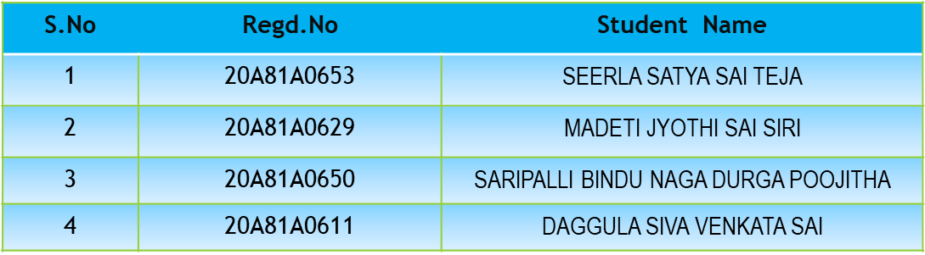

Mini Project Review-1
Batch No: 05
Project Title: CREDIT CARD FRAUD DETECTION USING MACHINE LEARNING
S.NO | REGD.NO | STUDENT NAME
1 | 21A81A05M8 | KARPURAM VYSHNAVI
2 | 21A81A05M9 | KARRI LAKSHMI SHANU ABHINAYA
3 | 22A85A0521 | KOTTA HARSHITHA LAKSHMI
4 | 22A85A0524 | PICHIKA LITISH KUMAR
5 | 21A81A05P7 | SOMISETTY BHARATH KUMAR
PROJECT GUIDE
Mrs.P.Ujwala Sai,M.Tech

Slide 2

MINI PROJECT REVIEW I-CONTENTS
* Abstract
* Introduction
* Literature Survey
* Problem Statement in Existing System
* Proposed System
* Objective
* Project domain
-Requirement analysis
- Functional Requirements
- Non-Functional Requirements
-Software Requirements
-Hardware Requirements
* System Architecture
* Methodology
* Project Plan

Slide 3
ABSTRACT
Now a days credit card frauds are the most frequently occurring problem in this world. This is mostly due to online transactions. Credit card fraud generally happens when the card was stolen for any of the unauthorized purposes. To detect the fraudulent activities the credit card fraud detection system was introduced. The main aim of project focus on machine learning algorithms. The algorithms that are used in this project are XG BOOST, ANN (Artificial Neural Networks),Naive Bayes. Misclassified data can be another major issue, as not every fraudulent transaction is caught and reported .To tackle this problem we need a system that can abort the transaction if it finds fishy .The main requirement is the past data and suitable algorithms.

Slide 4
INTRODUCTION
In our digital era, credit card convenience comes hand in hand with the growing risk of credit card fraud.
This succinct overview highlights the essence of credit card fraud detection, emphasizing its significance, technological foundations, and protective role in financial security. As technology advances, so do the tactics of fraudsters.
The urgent need for robust fraud detection systems has given rise to innovative solutions such as artificial intelligence (AI) and machine learning (ML).AI's speed and data analysis capabilities empower detection algorithms to spot subtle patterns and anomalies that evade human notice.
ML algorithms learn from historical transaction data, enhancing their ability to predict and detect fraudulent activities with accuracy.Data analytics further fuels this defense mechanism, helping institutions distinguish normal behaviors from suspicious actions.
Yet, challenges persist, including striking a balance between fraud detection and user privacy. This series will delve deeper into the mechanics of AI, machine learning, and data analytics in credit card fraud detection, equipping businesses and individuals to face the evolving landscape of financial security confidently.

Slide 5
LITERATURE SURVEY
Fraudulent Detection in Credit Card System Using SVM & Decision Tree (Vijayshree B. Nipane, Poonam S. Kalinge, Dipali Vidhate, Kunal War, Bhagyashree P.Deshpande).
With growing advancement in the electronic commerce field, fraud is spreading all over the world, causing major financial losses.
In the current scenario, Major cause of financial losses is credit card fraud; it not only affects tradesperson but also individual clients. Decision tree, Genetic algorithm, Metalearning strategy, neural network, HMM are the presented methods used to detect credit card frauds.
In contemplating system for fraudulent detection, artificial intelligence concept of Support Vector Machine (SVM) & decision tree is being used to solve the problem. Thus by the implementation of this hybrid approach, financial losses can be reduced to greater extent.

Slide 6
PROBLEM STATEMENT IN EXISTING SYSTEM
The existing system use’s the Random forest algorithm, being a bagging model, it generates decision trees and calculates their predictions in parallel.
The main disadvantage of this algorithm is that due to presence of a large number of trees , the algorithm can become quite slow and ineffective for real-time predictions.
Credit card transactions occur in real-time, and fraud detection systems need to process vast amounts of data quickly. Ensuring scalability and low-latency responses can be challenging.
Models that perform well in one geographic region or for one type of fraud might not generalize well to other regions or types of fraud. Ensuring that a model is effective across diverse scenarios is a challenge.

Slide 7
PROPOSED SYSTEM
The proposed credit card fraud detection system utilizes the XGBoost algorithm for accurate and efficient fraud identification.
Advantages
XGBoost offers high accuracy, handles complex relationships, addresses imbalanced data, provides feature importance insights, and is adaptable to various fraud detection scenarios, making it a powerful choice for credit card fraud detection.
XGBoost employs an ensemble learning approach, which combines the predictions of multiple weak models to create a stronger overall model.
XGBoost models can be periodically retrained with updated data to capture emerging fraud patterns and maintain detection accuracy.

Slide 8
OBJECTIVE
The objective of credit card fraud detection are to prevent financial losses by identifying unauthorized transactions, protect card holders from identity theft and misuse of their information, maintain trust in financial institutions and payment systems, minimize disruptions to legitimate transactions through accurate detection, and stay ahead of evolving fraud techniques to ensure system integrity and compliance.
Develop predictive models that accurately distinguish between legitimate and fraudulent transactions.
Detect fraud without causing unnecessary disruptions for legitimate cardholders.
Ensure that the fraud detection system can scale to handle increasing transaction volumes as the credit card user base grows.

Slide 9
PROJECT DOMAIN
Machine Learning is defined as a technology that is used to train machines to perform various actions such as predictions, recommendations, estimations, etc., based on historical data or past experience.
Machine Learning enables computers to behave like human beings by training them with the help of past experience and predicted data. There are three key aspects of Machine Learning, which are as follows:
Task: A task is defined as the main problem in which we are interested. This task/problem can be related to the predictions and recommendations and estimations, etc.
Experience: It is defined as learning from historical or past data and used to estimate and resolve future tasks.
Performance: It is defined as the capacity of any machine to resolve any machine learning task or problem and provide the best outcome for the same. However, performance is dependent on the type of machine learning problems.

Slide 10
REQUIREMENT ANALYSIS
Functional requirements
It should meet the functional requirements as mentioned in Objectives .
The system should assess the model's performance using metrics such as precision, recall, F1-score, and AUC-ROC on test data.
Non functional requirements
This project is intended to meet the following nonfunctional requirements
The credit card fraud detection system must provide accurate real-time detection, ensuring security scalability, and usability while adhering to industry standards and maintaining privacy.
The program should be platform independent.

Slide 11
SPECIFIC REQUIREMENTS
Software requirements
Languages: Python - 3 Version
Operating System: Windows
IDE: Microsoft Visual Studio Code/PyCharm/Jupyter
Hardware requirements
CPU: Intel Core I5 10500H
GPU: NVIDIA GPU WITH CUDA SUPPORT
Hard disk space: 20 GB or more
Memory: 8 GB RAM

Slide 12
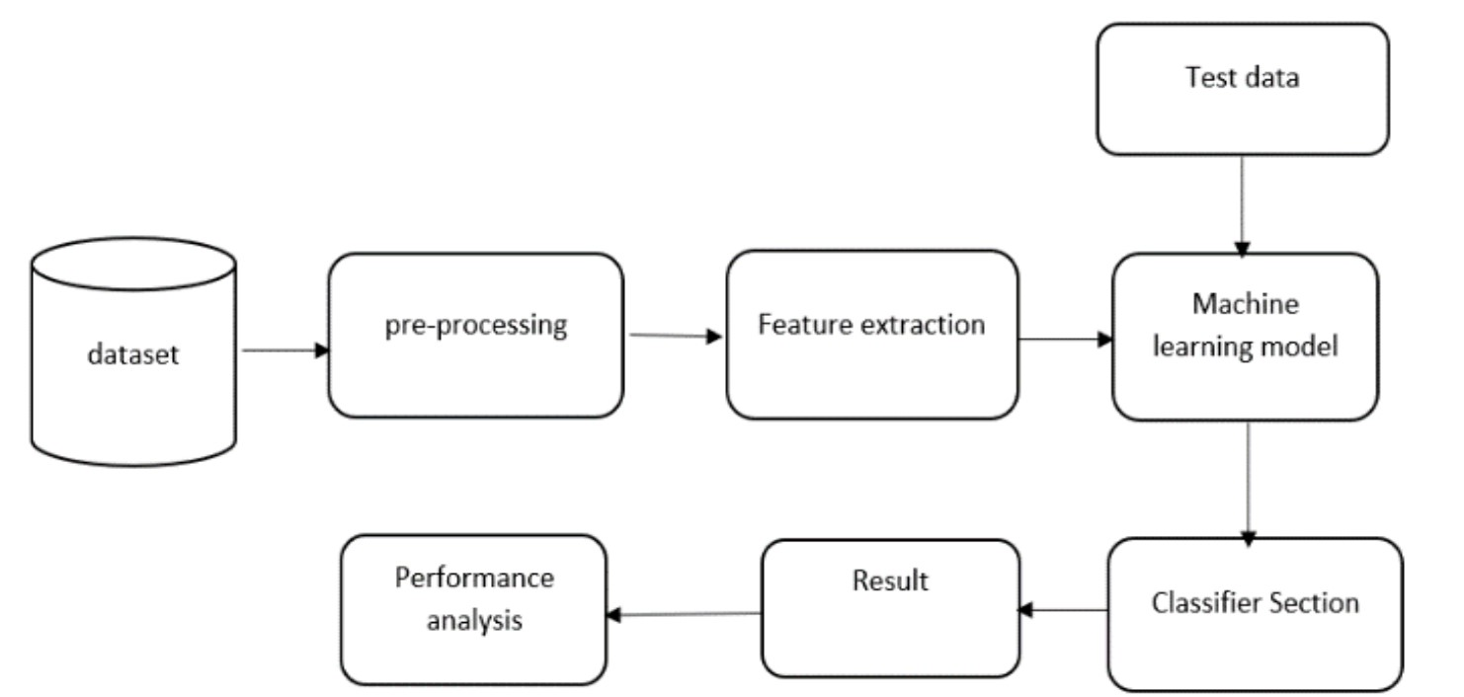
SYSTEM ARCHITECTURE

Slide 13
METHODOLOGY
Our methodology for credit card fraud detection encompasses several essential steps,initial data preparation involves cleaning and preprocessing the transaction data by handling missing values and scaling features.
Subsequently, feature engineering is performed to create meaningful variables and potentially reduce dimensionality.
The selection of the XGBoost algorithm is driven by its ensemble nature, making it suitable for tackling the challenges posed by imbalanced data in fraud detection.
The model is trained on the prepared data, where hyperparameters are fine-tuned through techniques like cross-validation to optimize its performance.

Slide 14
IMPLEMENTATION
Implement credit card fraud detection using XGBoost:
Prepare and preprocess data.
Split data for training and testing.
Define XGBoost parameters.
Train the model.
Evaluate using metrics.
Fine-tune hyperparameters.
Handle class imbalance.
Deploy and monitor the model.

Slide 15
PROJECT PLAN
Requirement collection and analysis: 10 Days
Program Design: 5 Days
Coding: 15 Days
Testing: 7 Days
Deployment: 10 Days

Slide 16


